Slide 1
Slides are from Level 3 Biology Course Content Day, 7th November 2012 Presenter: Teresa Holm Teachers are free to use these for teaching purposes with appropriate acknowledgement

Slide 2
Blood Pressure
Ways of looking at blood pressure that encourage higher thinking in the students – plus –
Some real content too, for the learning unit.

Slide 3
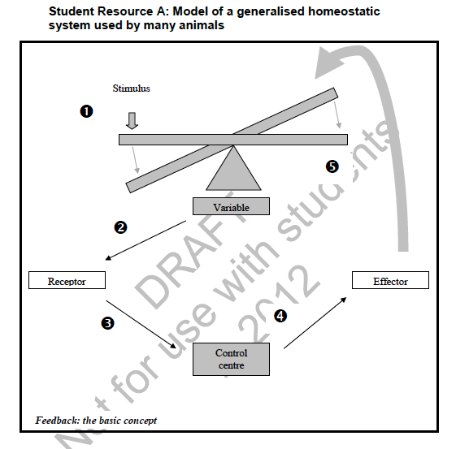
A sample of an NCEA Level 3 Homeostasis Task From TKI

Slide 4
Examples of Criteria for Achievement Homeostasis
Explain the purpose of the homeostatic mechanism
Be able to explain the basis of the homeostatic mechanism
Describe one way in which internal or external environmental factors can disrupt the homeostatic mechanism
Teacher Outreach Day 2012 Tom Mulvey’s Slides - Permission granted for use for teaching purposes

Slide 5
Examples of Excellence Criteria for Homeostasis
Be able to explain why it gives an adaptive advantage
An explanation of the biochemical/biophysical pathways involved
An analysis of how internal or external environmental factors can disrupt the homeostatic mechanism
Teacher Outreach Day 2012 Tom Mulvey’s Slides - Permission granted for use for teaching purposes

Slide 6
What’s the purpose of regulating blood pressure ?
Changes in blood pressure are routinely made in order to direct appropriate amounts of oxygen and nutrients to specific parts of the body. So if we are exercising, then more blood is sent to the muscles. Having eaten, more is sent to the gut to aid absorption.
Teacher Outreach Day 2012 Tom Mulvey’s Slides - Permission granted for use for teaching purposes

Slide 7
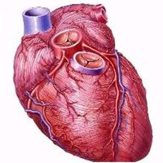
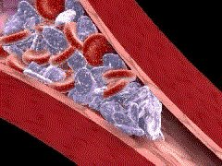
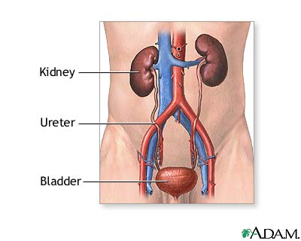
There are three main ways that blood pressure is adjusted
Cardiac output can alter by changing stroke volume or heart rate – whole/body effect.
Resistance to blood flow in the blood vessels is most often altered by changing the diameter of the vessels (vasodilation /vasoconstriction) local effect.
Control blood volume by controlling amount of water released into urine whole/body effect.
H₂0
Teacher Outreach Day 2012 Tom Mulvey’s Slides - Permission granted for use for teaching purposes

Slide 8
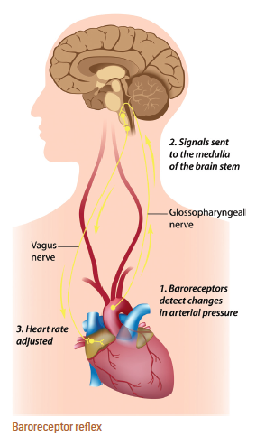
Some mechanisms that work to alter blood pressure.
The cardiovascular center provides a rapid, neural mechanism for the regulation of blood pressure by managing cardiac output or by adjusting blood vessel diameter.
It is located in the medulla oblongata of the brain stem. There are three distinct regions (this is excellence material for our NCEA Students)
Teacher Outreach Day 2012 Tom Mulvey’s Slides - Permission granted for use for teaching purposes

Slide 9
Three regions are:
The cardiac centre – increases cardiac output by signaling using sympathetic cardiac nerves.
Cardiac centre again – decreases cardiac output parasympathetic vagus nerves.
The vasomotor center regulates blood vessel diameter affecting vasomotor tone providing a steady state of vasoconstriction for each organ.
Teacher Outreach Day 2012 Tom Mulvey’s Slides - Permission granted for use for teaching purposes

Slide 10
Let’s start then. Heart and circulatory system
Things to Think About
Ways to get your class thinking about blood pressure throughout the body –
rubber glove demonstrations.
What causes fainting?
What is the effect lying down v standing up?
What is the effect of putting tight stockings on?
Teacher Outreach Day 2012 Tom Mulvey’s Slides - Permission granted for use for teaching purposes

Slide 11
What causes raised or lower blood pressure in people?
Things to Think About
Class thinking again. Leading questions:
We have a pump. It pumps through a system. What happens if we block the system a bit? If we block it a lot?
The arteries expand to accept each pulse of blood. What would happen if they were less elastic?
What would happen if we reduced the amount of liquid (blood) available? Or had too much?
Teacher Outreach Day 2012 Tom Mulvey’s Slides - Permission granted for use for teaching purposes

Slide 12
Hypertension high blood pressure
Here are three potential deadly consequences:
Coronary heart disease. The heart becomes enlarged and weakens. Possible myocardial infarction (i.e heart attack) or stroke due to the pressure inducing a rupture of fatty deposits in the walls of blood vessels which results in blood clots inside the blood vessels of the heart or the brain respectively. This blocks blood flow which results in tissues becoming starved of blood and oxygen and so the affected tissues die.
Aneurysm (bulge in arteries) can be lethal and need intervention.
Kidney damage, fluid retention, leading to even higher blood pressure and ultimately total kidney failure.
There are no outstanding symptoms of hypertension so it is sometimes referred to as the ‘silent killer’.
However it is very easy to measure so now clinicians monitor it routinely.
Teacher Outreach Day 2012 Tom Mulvey’s Slides - Permission granted for use for teaching purposes

Slide 13
How Do We Measure Blood Pressure
Things to Think About
When we say we are measuring blood pressure we are usually measuring the arterial blood pressure in the brachial artery in the upper arm
We measure blood pressure by cutting off blood flow with the cuff around the arm then releasing the pressure on the cuff until blood flows again. The pressure at which this happens corresponds to the maximum pressure of the blood during the heart cycle and is called the systolic pressure. Pressure release continues until blood flow is normal. The pressure at which this happened is called the diastolic pressure
Pressure measured in millimeters of mercury and expressed as systolic/diastolic, for example 140/90
Teacher Outreach Day 2012 Tom Mulvey’s Slides - Permission granted for use for teaching purposes

Slide 14
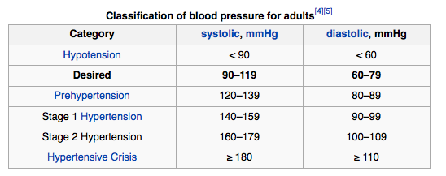
Things to Think About

Slide 15
Low bp – hypotension
One cause is massive bleeding results in reduced blood volume. Individual goes into shock.
Treatment: stop bleeding, replace blood.
Serious infection
Another cause is anaphylaxis caused by severe allergic reaction which caused vasodilation and leaking of fluid from blood vessels into surrounding tissues (which causes the characteristic swelling)
Treatment: adrenaline by injection.
Causes vasoconstriction and restores bp rapidly.
Teacher Outreach Day 2012 Tom Mulvey’s Slides - Permission granted for use for teaching purposes

Slide 16
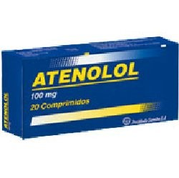
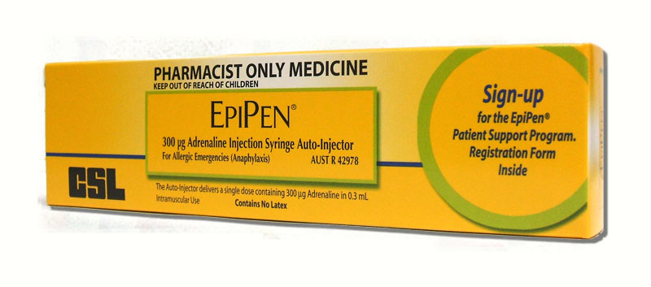
Adrenaline and Blood Pressure
Things to Think About
Adrenaline (or as Americans call it, epinephrine) increases blood pressure by increasing heart rate and constricting capillaries
This is a good thing to do if you need to urgently increase blood pressure e.g. during anaphylactic shock after allergic reactions. That’s why many allergy sufferers carry Epipens which are syringes containing adrenaline.
Teacher Outreach Day 2012 Tom Mulvey’s Slides - Permission granted for use for teaching purposes

Slide 17
Ways to head off hypertension
Major causes are:
Being overweight, inactivity and poor diet. And it is associated with old age.
So the ways to combat it follow logically:
Adopt a healthy lifestyle: achieve a reasonable level of fitness by engaging in regular moderate exercise.
And eat healthily.

Slide 18
Drugs for hypertension
Drugs act in broadly four ways to reduce blood pressure. Let’s look at those, based on the knowledge from our previous slides.
1 Reduce the amount of fluid available to be pumped (diuretic).
2 Use beta-blockers to slow the heart and reduce the stroke volume.
Teacher Outreach Day 2012 Tom Mulvey’s Slides - Permission granted for use for teaching purposes

Slide 19
Two more drug strategies that are related
3 Use alpha-blockers to relax the capillaries and so reduce the resistance to blood flow.
4 Use ACE inhibitors. They reduce the production of angiotensin-converting enzyme needed to produce angiotensin II which actually tightens the capillaries and increases the resistance to blood flow and hence increases the pressure. We’ll cover this shortly
Teacher Outreach Day 2012 Tom Mulvey’s Slides - Permission granted for use for teaching purposes

Slide 20
Let’s have some order! Regulation of blood pressure
We have three main ways of signaling for blood pressure control:
Baroreceptors (that was easy, little pressure sensors that measure the arterial pressure).
Major baroreceptors are located in the carotid sinus (an enlarged area of the carotid artery just above its separation from the aorta), the aortic arch, and the right atrium.
Teacher Outreach Day 2012 Tom Mulvey’s Slides - Permission granted for use for teaching purposes

Slide 21
These also signal the cardiac centre.
Chemoreceptors are sensory neurons that monitor levels of CO₂ and O₂. These neurons alert the cardiovascular center when levels of O₂ drop or levels of CO₂ rise (which result in a drop in pH). Chemoreceptors are found in carotid bodies and aortic bodies located near the carotid sinus and aortic arch.
Teacher Outreach Day 2012 Tom Mulvey’s Slides - Permission granted for use for teaching purposes

Slide 22
Hormonal signaling
Higher brain regions, such as the cerebral cortex, hypothalamus, and limbic system, signal the cardiovascular center when conditions (stress, fight-or-flight response, hot or cold temperature) require adjustments to the blood pressure.
Teacher Outreach Day 2012 Tom Mulvey’s Slides - Permission granted for use for teaching purposes

Slide 23
The kidneys
The kidneys provide a hormonal mechanism for the regulation of blood pressure by managing blood volume. The renin-angiotensin-aldosterone system of the kidneys regulates blood volume. In response to lower blood pressure, the juxtaglomerular cells in the kidneys secrete renin into the blood. Renin converts the plasma protein angiotensinogen to angiotensin I, which in turn is converted to angiotensin II by enzymes from the lungs. Angiotensin II activates two mechanisms that raise blood pressure:
Teacher Outreach Day 2012 Tom Mulvey’s Slides - Permission granted for use for teaching purposes

Slide 24
Angiotensin II constricts blood vessels throughout the body (raising blood pressure by increasing resistance to blood flow). Constricted blood vessels reduce the amount of blood delivered to the kidneys, which decreases the kidneys' potential to excrete water (raising blood pressure by increasing blood volume).
Angiotensin II stimulates the adrenal cortex to secrete aldosterone, a hormone that reduces urine output by increasing retention of H₂O and Na⁺ by the kidneys (raising blood pressure by increasing blood volume).
Teacher Outreach Day 2012 Tom Mulvey’s Slides - Permission granted for use for teaching purposes

Slide 25
Examples of bp-altering hormones:
Arenaline and Nor-adenaline (Epinephrine and nor-epinephrine), hormones secreted by the adrenal medulla, raise blood pressure by increasing heart rate and the contractility of the heart muscles and by causing vasoconstriction of arteries and veins.
Teacher Outreach Day 2012 Tom Mulvey’s Slides - Permission granted for use for teaching purposes

Slide 26
Examples of bp-altering hormones:
Antidiuretic hormone (ADH), a hormone produced by the hypothalamus and released by the posterior pituitary, raises blood pressure by stimulating the kidneys to retain H₂O (which increases bp by having more fluid available).
Teacher Outreach Day 2012 Tom Mulvey’s Slides - Permission granted for use for teaching purposes
Teacher Outreach Day 2012 Tom Mulvey’s Slides - Permission granted for use for teaching purposes

Slide 27
Examples of bp-altering hormones:
Atrial natriuretic peptide (ANP), a hormone secreted by the atria of the heart, lowers blood pressure by causing vasodilation and by stimulating the kidneys to excrete more water and Na⁺ - so lowering blood pressure by reducing blood volume.
Teacher Outreach Day 2012 Tom Mulvey’s Slides - Permission granted for use for teaching purposes

Slide 28
Examples of bp-altering hormones:
Nitric oxide (NO), secreted by endothelial cells, causes vasodilation. Not a hormone of course, but we’ll leave it here anyway.
Teacher Outreach Day 2012 Tom Mulvey’s Slides - Permission granted for use for teaching purposes

Slide 29
Natural substances that affect blood pressure
Nicotine in tobacco raises blood pressure by stimulating sympathetic neurons to increase vasoconstriction and by stimulating the adrenal medulla to increase secretion of epinephrine and norepinephrine.
Teacher Outreach Day 2012 Tom Mulvey’s Slides - Permission granted for use for teaching purposes

Slide 30
Natural substances that affect blood pressure
Alcohol lowers blood pressure by inhibiting the vasomotor center (resulting in vasodilation)
and by inhibiting the release of ADH (therefore increasing H₂O (urine) output, which decreases blood volume).
Teacher Outreach Day 2012 Tom Mulvey’s Slides - Permission granted for use for teaching purposes

Slide 31
Cool info, to finish off.
Why are blood pressures the same across all mammals?
It’s a question of resistance.
Large animals pump more blood, but they have wider blood vessels.
So what happens to the resistance as the vessels become smaller? There are more of these smaller vessels and the cross-section area stays about the same.
Teacher Outreach Day 2012 Tom Mulvey’s Slides - Permission granted for use for teaching purposes

Slide 32
Big animals and small animals
Large animals have larger hearts that beat slower
Small animals’ hearts beat much faster
Mouse – 580 beats per minute
Rat – 380 beats per minute
Me – 60 beats per minute
Elephant – 28 beats per minute
Teacher Outreach Day 2012 Tom Mulvey’s Slides - Permission granted for use for teaching purposes

Slide 33
Thinking exercise
Small animals’ hearts beat faster
Small animals live shorter lives
Which achieves more pulses in their lifetimes? Small or large animals? Answer – it’s about the same – one billion pulses each. Then you die.
Teacher Outreach Day 2012 Tom Mulvey’s Slides - Permission granted for use for teaching purposes

Slide 34
What about the giraffe? Thinking exercise for the class
How can they raise the blood 2 metres from heart to brain?
Relatively small heart but very thick walls that pumps very strongly.
Results in very high blood pressure (300) by far the highest of any mammal
Teacher Outreach Day 2012 Tom Mulvey’s Slides - Permission granted for use for teaching purposes

Slide 35
Thinking exercise for the class
How might the giraffe prevent blood pooling in their legs?
Have a tight skin, just like an astronaut’s pressure suit.
Compare with the baggy skin around a cat’s legs, or around a lion’s. Try it with your cat next time you get the chance, pinch the skin at the leg and see how much slack there is.
To compare, do the same with the lion and giraffe next time you are at the zoo.
Teacher Outreach Day 2012 Tom Mulvey’s Slides - Permission granted for use for teaching purposes

Slide 36
How many blood pump systems is best?
Fish have only one – blood flows from the heart to the gills then through the body.
But we have two. The left side and right side.
One for the small circulation (lungs only)
One for the circulation through the rest of the body.
They’re joined together so only count as one heart.
Teacher Outreach Day 2012 Tom Mulvey’s Slides - Permission granted for use for teaching purposes

Slide 37
Big implications for blood pressure
The right side pumps blood at relatively low pressure through the lungs and to the left side
The left side pumps the blood through the entire body and requires higher pressure.
So it’s bigger and much stronger.
Teacher Outreach Day 2012 Tom Mulvey’s Slides - Permission granted for use for teaching purposes

Slide 38
How do the ventricles pump?
Preloading the chamber with blood – then squeezing. But in a special way, rotating as well as contracting.
(Try wet towel experiment with your class)
Teacher Outreach Day 2012 Tom Mulvey’s Slides - Permission granted for use for teaching purposes

Slide 39
Isolated rat liver perfusion apparatus feel free to come by this afternoon

